Slide 1
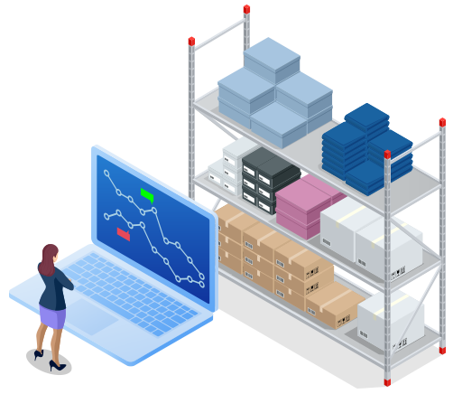
Data-Driven Inventory Management
Angel Wei Huang
STOR 892 Final Project
November 5, 2020

Slide 2
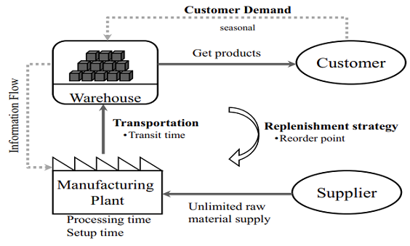

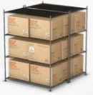

The problem
Data-driven model
How much and when?
Storage cost
Unsatisfied
demand
Grewal et al. (2015)
Notes:
Inventory management is a big field that is relevant to any business that holds inventory. The goal of inventory management is to have the right stock, at the right levels, in the right place, at the right time, and at the right cost as well as price.
Here is a simplified model of a capacitated supply chain from Grewal et al. It consisted of customers demanding product, a finished goods warehouse that delivers product to customer, a manufacturing plant that takes raw material and manufactures final product, a transport system that moves product from manufacture to warehouse, and a replenishment order system that warehouse uses to determine \\ how much stock to have in house and when to reorder.
\\ The focus of my project is on replenishment strategy, which is one of the most important decision-making steps in the whole process.
The balance we need to consider is to not have too much excess storage which cost money to maintain, and also not have too little storage that we can’t satisfy all of the demand, which also might cost the business to loss its reputation or even loss its customers. The goal of my project is to build models that are driven by real-life data to balance these two factors.

Slide 3
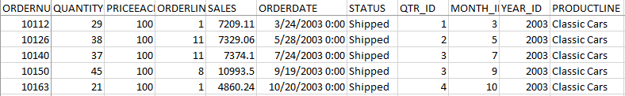
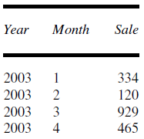
Data preprocessing
Data from https://www.kaggle.com/kyanyoga/sample-sales-data7
Pick one product: classic cars
Combine different sub-models (orderline) of classic cars
Ignore price differences between sub-models
Aggregate quantity sold by month
Notes:
I obtained data from Kaggle sales dataset, which is organized by transaction, each row represents a transaction and has information on quantity, price, order date etc.
To focus on model building, here I picked one product “classic cars”, since the model can be easily generalizable to other products.
I also combined different orderlines which represents different sub-models under classic cars, and considered them homogenous product with the same price
At last, I aggregate the quantity sold by month to obtain a time series of sale as shown on the right.

Slide 4
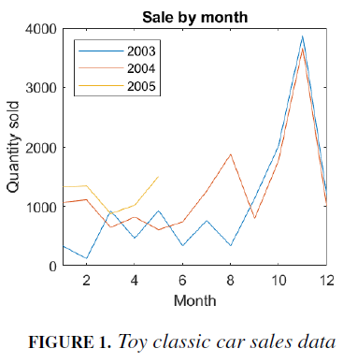
Sales data
Notes:
Here is an overview of the monthly sales data over 3 years, from January 2003 to May 2005. Y axis showing the sales and x axis showing the month in each year, color encodes for different years. The sales quantity fluctuated from 120 to around 4000. It is worth pointing out that there was a seasonal trend in the data with October and November showing the highest sales, which was three to four times higher than normal, probably
due to the Christmas season when people are buying more toys.

Slide 5
Models
1. Linear programming based on all time periods
2. Linear programming with m-policy
3. Neural network demand forecasting

Slide 6
Model 1. Linear programming based on all time periods
At the beginning of each time period i (1 ≤ i ≤ n total number of time periods)
We have X_{i} quantity of inventory on-hand
There will be D_{i} amount of demand during this period
We do not know the real demand, so use the sales data to simulate the demand
Goal: to decide A_{i}, the amount to order at the end of period i.
Notes:
At the beginning of each time period i, which is between 1 and n total number of time periods (here each time period is a month, but this model can
be easily generalized to other time units), we have Xi quantity of inventory on-hand.
There will be Ai amount of demand during this period. Since we do not have data for
the actual demand, we use the sales data to simulate the demand. We need to decide
Ai, the amount to order at the end of period i. It arrives at the beginning of period
Xi+1

Slide 7
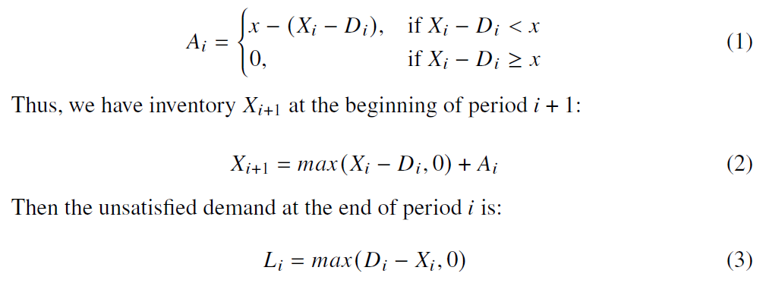
Model 1. Linear programming based on all time periods
Policy: if the inventory on hand falls below a certain threshold x, we will order A_{i} to make up the difference, otherwise we will not order.
Notes:
We employ a reordering policy that if the inventory on hand falls below a certain
threshold x, we will order Ai to make up the difference, otherwise we will not order.
We assume it takes 1 time period for the order to arrive, thus we have inventory
Xi+1 at the beginning of period i+1, which is the sum of the residual inventory plus the new order
Then, the unsatisfied demand at the end of period i is the positive value of Di-Xi

Slide 8
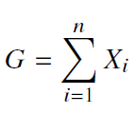

Model 1. Target function
Optimizing --
Minimizing inventory
Satisficing –
No more than 5% unfulfilled demands
Notes:
For our target function, we have an optimization criteria which is to minimize the total inventory
On the other hand, we also have a satisficing criteria which we set to be no more than 5% unfulfilled demands

Slide 9
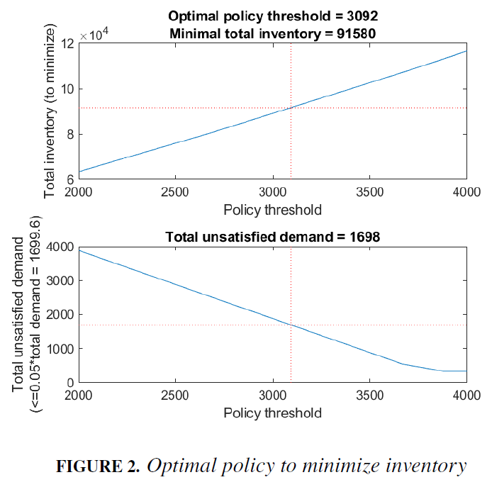
Model 1. Optimal policy
Notes:
I simulated the sale process for each order policy with quantity x and showed the result in Figure 2.
The top plot shows total inventory on the y axis. For each quantity x from 2000 to 4000, with increment of 1, the total inventory increased linearly which makes sense. The bottom plot shows the total unsatisfied demand which decrease linearly from x=2000 until around 3600 and then flatten out at around x=3900, by which time the unsatisfied demand is minimum, which is the first month’s order 334, since we had 0 inventory on hand at the beginning. Based on our satisficing criteria, we would only consider policy that has no more than 5% unsatisfied demand, which is below the red dotted horizontal line in the bottom plot. This yield available options of policy being x>= 3092. Then we can consider minimize inventory in the top plot, which is a positively linearly correlated to x. Thus the optimal policy threshold is x = 3092, the minimal total inventory is 91580, and the total unsatisfied demand is 1698 (< .05*total demand = 1699.6).

Slide 10
Models
1. Linear programming based on all time periods
2. Linear programming with m-policy
3. Neural network demand forecasting
Notes:
In this model, we assumed that we know data in all the time periods and x was chosen based on all the data. It is clearly not the case in reality, in which the future demand is unknown so we can’t use that data for deciding x.
To come up with a more sensible policy that can guide our decision in real time, I upgraded the policy to only take into account data in a fixed time window m just before the decision
period, I call this "m-policy".

Slide 11
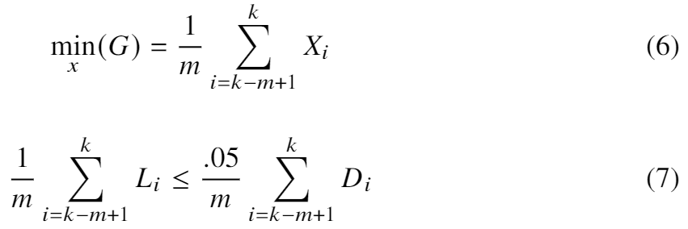
Model 2. Linear programming with m-policy
Choose a time window m (2 ≤ m ≤ 15 months)
Use data from previous m time periods (periods k-m+1, k-m+2,…, k, k ≥ m) as training data
Use data from the next time period (k+1) as test data
Find x for each time window m as described in model 1 with small modification (6) with constraint (7)
Notes:
For m policy, I first choose a time window m that is between 2 to 15 months – I chose 15 to make sure we cover a whole year as well as have enough training samples
I use data from previous m time period as training data, and use data from the next time period as test data
The selection of reorder point x for each time window m is as described in model 1, with a small modification. In stead of using total inventory and total unsatisfied demand, I am using monthly average inventory and unsatisfied demand here.
Then I compared average resulted inventory per month for each m and determined the best m and its corresponding x to be the optimal policy.

Slide 12
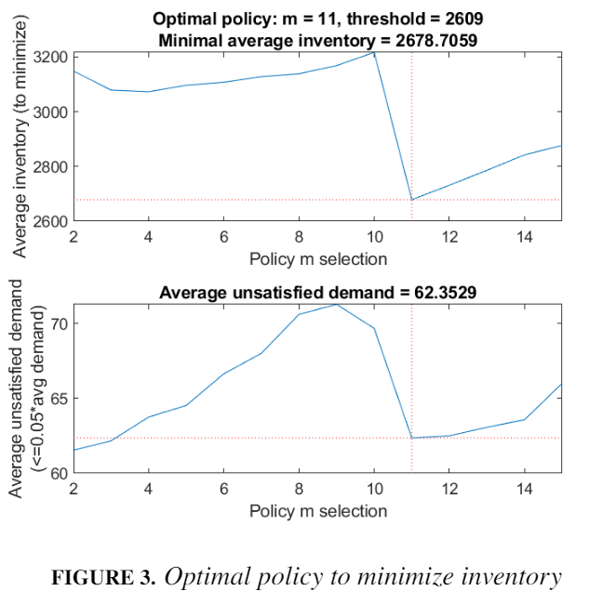
Model 2. Linear programming with m-policy
Notes:
Figure 3 shows the optimal policy under each m parameter. The top plot shows that when we choose data from m time periods to guide ordering decision, the minimum average monthly inventory we can achieve. The inventory stayed at a relatively high level around 3100, with 10 months resulting in the highest average inventory. However, when using data from 11 previous months’ for decision-making, we found a dip inaverage inventory to around 2679, which is also the minimum average inventory wecan achieve given the parameter space we were searching from. This makes sense intuitively because we have found a seasonal trend in Figure 1, so having data up to almost a year is very helpful in guiding the inventory decisions. Interestingly, as we include data from more month (m >11), the average inventory starts to go up again, suggesting that too big a time window might introduce more noise.
The next constraint we care about is the unsatisfied demand. Since we had applied this constraint to get each x, we know that each x resulted in less than 5% unsatisfied demand for each given m, the exact demand amount is different due to the difference in testing data set for each m (since there are different number of months used in training set). So we also plot average unsatisfied demand against parameter m on the bottom plot. It was clear that m=11 also yields one of the lowest average unsatisfied demand, besides m=3 and m=4. In summary, it was reassuring that when using data from previous m=11months, we were able to minimize average inventory, as well as keeping the average unsatisfied demand below 5%.

Slide 13
Models
1. Linear programming based on all time periods
2. Linear programming with m-policy
3. Neural network demand forecasting
Notes:
So far, we have been using a fixed reorder quantity for all time periods, but as we have seen before, the sale fluctuates seasonally, so can we use a dynamic threshold based on previous m time periods data?
This means that we would need to forecast the demand for each month before hand. There are many established time series forecasting methods, here I would like to try a relatively new method neural network, which was suggested to perform better than other methods.

Slide 14
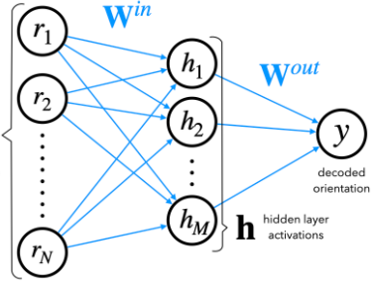
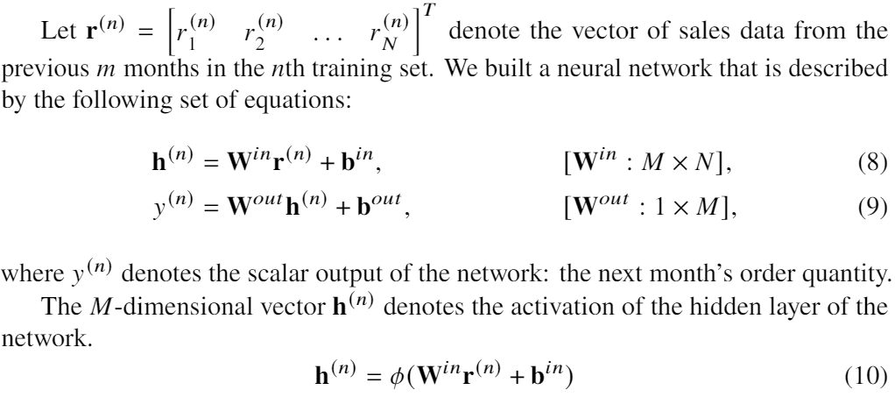
Model 3. Neural Network¹
N
1. McCulloch, W. S., & Pitts, W. (1943). A logical calculus of the ideas immanent in nervous activity. The Bulletin of Mathematical Biophysics, 5(4), 115–133.

Slide 15
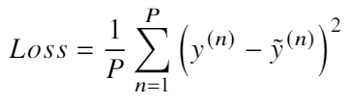

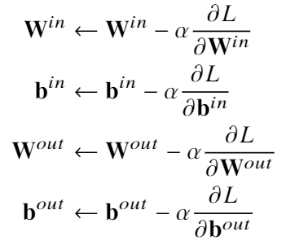
Model 3. Neural Network – Gradient Descent²
Evaluate the loss on the training data.
Compute the gradient of the loss with respect to each of the network weights.
Update the network weights by descending the gradient that was calculated in step 2.
2. Ruder, S. (2016). An overview of gradient descent optimization algorithms. ArXiv Preprint ArXiv:1609.04747.
Notes:
Where alpha is the learning rate, which is a hyperparameter that can be tuned to adjust how big a step the algorithm take with respect to the gradient.

Slide 16
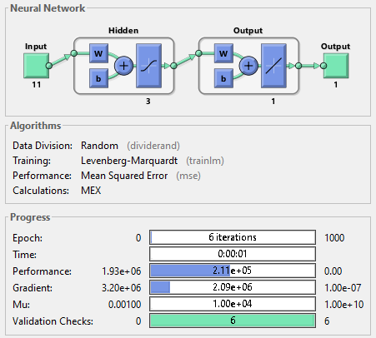
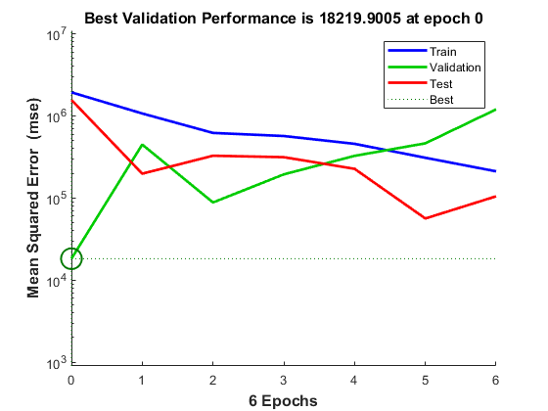
Model 3. Neural Network – training example (m=11)
Notes:
Here I am showing an example training process, on the top is a
Validation checks show how long it takes the algorithm to converge and that further training would not improve the performance.

Slide 17
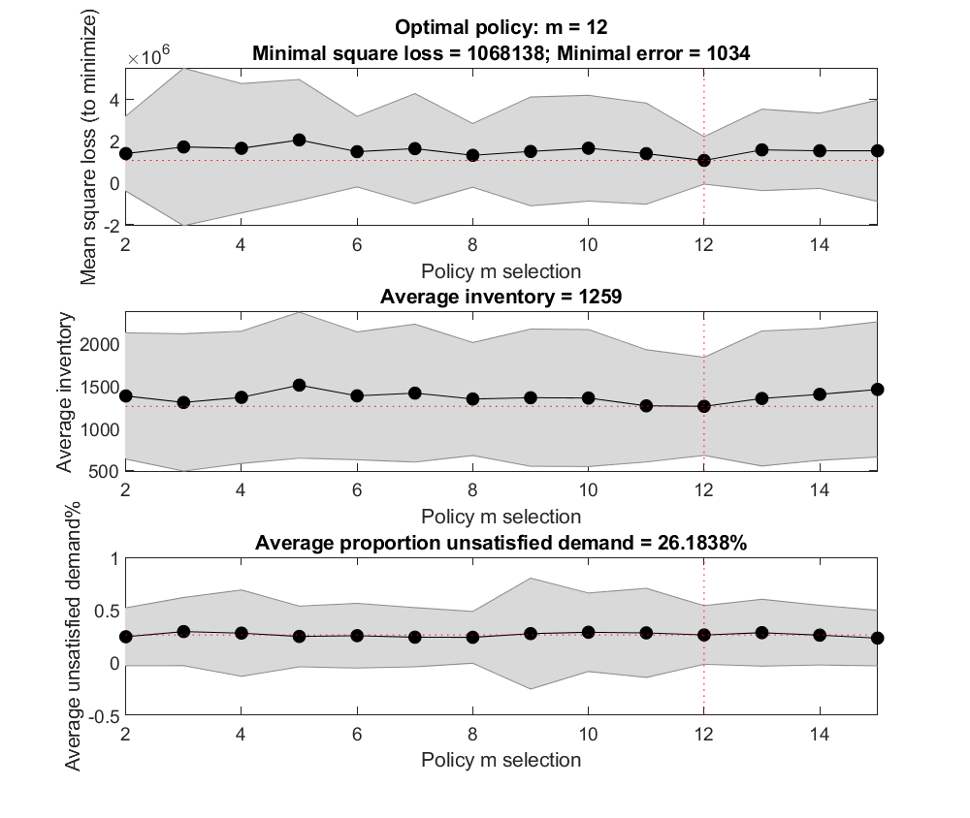
Model 3. Neural Network – result
60:20:20 training:validation:test split
100 iteration to calculate performance on test set
Much lower inventory, but with higher unsatisfied demand
Notes:
Here we find the best policy m to be 12 month, very close to the solution from the 11 month given by the m-policy
Using previous 12 months data, we can achieve the minimal mean square loss, and an average inventory of 1259, which is about half of the solution from the m-policy.
However, this is at the cost of much higher unsatisfied demand, which makes sense since the target for NN is to minimize prediction error without considering unsatisfied demand.

Slide 18
Conclusion
1. Linear programming based on all time periods
Not realistic, demands more data
2. Linear programming with m-policy
More sensible and applicable, less demand for data storage (just moving window)
3. Neural network demand forecasting
Limited performance on small dataset
Add sequence information might help (eg. Long short-term memory RNN)

Slide 19
Future Direction
Choose different target function or a combination of target functions
Instead of weighing all m previous months equally in m-policy, one can choose different weights for the previous months (eg. weight recent months more heavily) when trying to predict the inventory.
Other methods for time series forecasting given enough data: eg. auto-regression, recurrent neural network, to better predict the future inventory.
Notes:
Choose different target function or a combination of target functions (eg. assign value to the cost of unsatisfied demand and then combine the cost of inventory and unsatisfied demand so that there is only a single target function).

Slide 20

Thank you!
Questions?

